Slide 1

Big Data Session
-Nitin Arora
-Ramkumar Sreeram

Slide 2
Distributed Systems
In early computing days we were not dealing with large amounts of data but a lot of processing work was done on data
More processing requires more hardware, which resulted in larger single machines
You cannot continue to make machines bigger due to engineering limitations. This is where Distributed systems were introduced by Mr. Grace Hopper
Distributed systems are multiple machines which all work together using programs/software that makes it possible to work together.

Slide 3
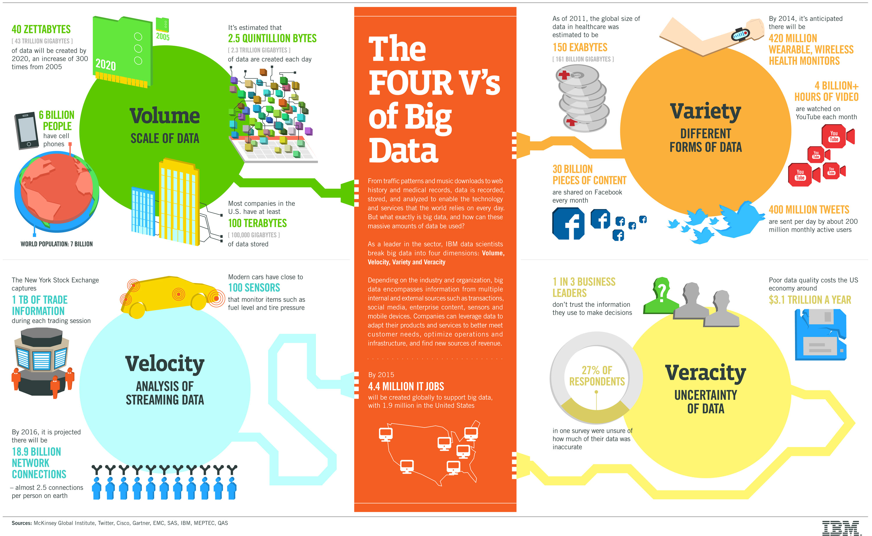

Slide 4
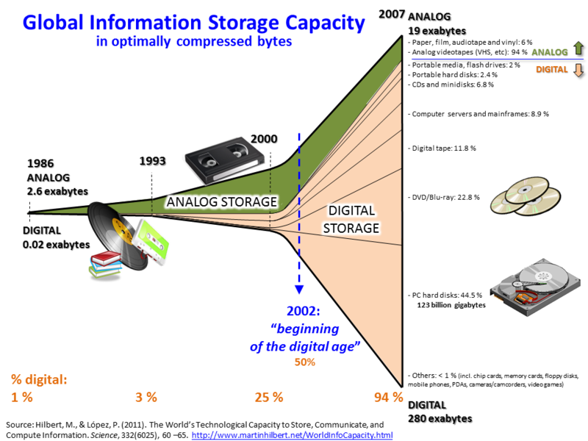
Big Data
Isn’t “Big Data” just the latest fad in technology? -- NO
So Large and complex that traditional data processing software is inadequate to deal with them.
Hence, it is changing the face of the industry – every one wants it.
How valuable is it ?
Data is growing so rapid - The world's technological per-capita capacity to store information has roughly doubled every 40 months since the 1980s and as of 2012, every day 2.5 exabytes (2.5×1018) of data are generated.
Main Components and ecosystem of Big Data
Techniques for analyzing data, such as machine learning and natural language processing
Big data technologies, like business intelligence, cloud computing and databases
Visualization, such as charts, graphs and other displays of the data
Source: https://en.wikipedia.org/wiki/Big_data

Slide 5
Google’s Solution for Distributed Systems
Google came up with GFS, the Google File System, to solve the issues with Distributed Systems
GFS stores large volumes of data and Distributed MapReduce processes that data
Hadoop is based on the solution used by Google in the 1990’s and published in 2003-2004
Doug Cutting was working on an open source project called Nutch and used Google’s publications to solve the problem, which lead to Hadoop.

Slide 6
The Hadoop Solution
Bring the Program to the Data rather than bringing Data to the Program
Distribute Data when data is stored
Run computations where the data reside

Slide 7
What is Hadoop?
Hadoop is an Infrastructure Software for processing, storing, and analyzing large volumes of data. The software part handles distribution of data, handling failures etc., while the hardware part handles the storage of data and processing power
Hadoop is Distributed –Hadoop cluster can have several machines
Hadoop is Scalable –You can add more machines to the cluster which proportionally adds capacity
Hadoop is Fault-tolerant –It can recover from hardware failures
Master re-assigns work
Data is replicated on by default on 3 machines
Nodes which recover rejoin the cluster automatically
Hadoop is Open Source
Overseen by Apache
Close to 100 Committers from companies like Cloudera, Hortonworks,

Slide 8
What is Hadoop - Continued
Tools built in the Hadoop ecosystem can be extended to handle many different tasks like:
ETL
BI
Data Storage
Predictive and Statistical Modeling
Machine Learning
Others

Slide 9
Core Hadoop Components
Hadoop Distributed File System (HDFS)
Can store any type of file
Data is automatically split into chunks and replicated for high availability
MapReduce
Processing framework to process the data
Other processing frameworks available now too
YARN (Yet Another Resource Negotiator)
Manages the resources in the cluster for job processing
Schedules jobs

Slide 10
Hadoop Ecosystem
Tools built around ‘Core Hadoop’ are known as Hadoop Ecosystem
All Hadoop Ecosystem tools are open source
Tools are designed to extend Hadoop’s functionality
New tools are added all the time
Hadoop Ecosystem projects included in CDH:
Spark –In-memory and Streaming processing framework
HBase –NoSQL database built on HDFS
Hive –SQL Processing engine designed for batch workloads
Impala –SQL Query Engine designed for BI workloads
Parquet –Columnar data storage format
Sqoop –Data movement/ETL to and from RDBMS
Flume, Kafka –Streaming data ingestion
Solr –Text search functionality
Hue –Web based user interface for Hadoop
Sentry –An authorization tool for managing security

Slide 12
Hadoop Distributions
Hadoop is Open source and can be downloaded from Apache website
Most organizations prefer enterprise-ready distribution of Hadoop which is
Tested thoroughly
Supported
Integrates well with Hadoop projects and other key software like ETL tools and Databases
Cloudera, Hortonworks, and MapR are the most widely used enterprise-ready Hadoop Distributions

Slide 13
Hadoop Cluster Terminologies
A cluster is a group of computers working together
A node is an individual computer in the cluster
There are two kind of nodes; Master node (Name Node) and Worker nodes (Data Node)
Master nodes manages distribution of work and data to worker nodes
A daemon is a program running on a node
Commodity hardware is an affordable system without expensive options like RAID or hot swappable CPUs.
Applies mainly to Data nodes; Name nodes should be high quality and very reliable

Slide 14
Master Node
Master nodes –manage the work
Coordinate the work and data storage on the cluster
Daemons running on the master nodes ensure that the entire cluster works
There are daemons for HDFS and YARN which control the entire cluster
A failed daemon on Master node may result in the entire cluster to be unavailable
Thus Master nodes are configured for high availability in an active-passive mode
Master nodes use Carrier-class hardware
Dual power supplies
Dual Ethernet cards
Hard drives use RAID (redundant array of inexpensive disks) to protect from data loss
Reasonable amount of RAM and reasonable number of CPU’s required
64 GB for 20 nodes or less
96 GB for up to 300 nodes

Slide 15
Worker Nodes
Worker nodes –perform the work
Can be scaled horizontally
Daemons on worker nodes handle the data processing
A failed worker node does not bring the cluster down because of data replication and high availability
Worker node hardware
Midrange CPUs are okay
More RAM the better
Memory intensive processing framework and tools are being used e.g. Spark and Impala
HDFS caching can take advantage of extra RAM
512 GB RAM/node or better is not uncommon
More disk is needed
By default the HDFS data is replicated 3 times
20-30% of cluster capacity is needed for temporary raw storage
4 x your data storage need is a good number for estimation
A good practical maximum is 36 TB per worker node
12 x 3TB drives
Mechanical hard drives currently provide better cost than SSD drives
7200 RPM SATA/SATA II drives are fine; no need to buy 15000 RPM drives

Slide 17
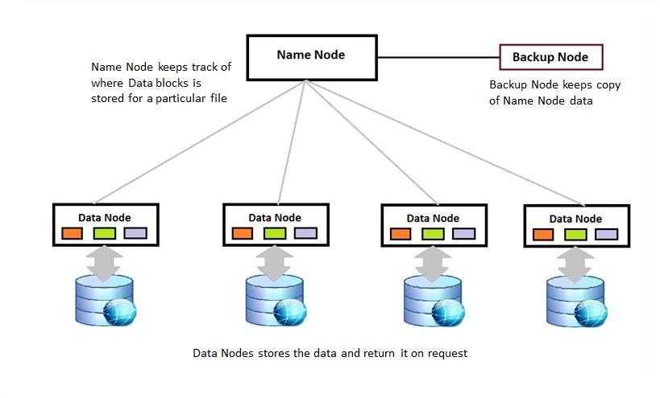
Hadoop Architecture
Source: http://saphanatutorial.com/

Slide 18
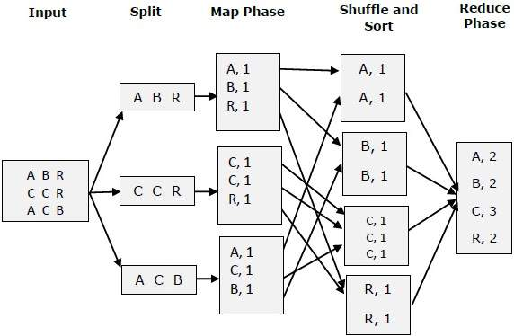
Hadoop Processing Framework: Map Reduce
Source: tutorialspoint

Slide 19
HDFS -Blocks
Uses Blocks to store a file or part of a file
Default size is 64MB, Recommended size is 128MB
Compare to 4KB in UNIX file system
One HDFS Block comprises of many OS Blocks
Blocks only use the needed space to store a file
E.g. a 280 MB file uses 2 x 128 MB blocks and 24 MB from the 3rdblock as opposed to consuming the whole 3rd block
Blocks are replicated to multiple nodes, which allows for a fault tolerant system if a node fails
Replication factor is configurable to determine how many copies of a file are kept
Default is 3 copies of each block on different nodes

Slide 20
How Data is Stored in HDFS

Slide 21
Data is Stored in HDFS

Slide 22
HDFS Commands
ls - hdfs dfs -ls /user/hadoop/file1
mkdir - hdfs dfs -mkdir /user/hadoop/dir1 /user/hadoop/dir2
cat - hdfs dfs -cat file:///file3 /user/hadoop/file4
copyFromLocal - hdfs dfs -copyFromLocal <localsrc> URI
put - hdfs dfs -put localfile /user/hadoop/hadoopfile
copyToLocal - hdfs dfs -copyToLocal URI <localdst>
get - hdfs dfs -get /user/hadoop/file localfile
cp - hdfs dfs -cp /user/hadoop/file1 /user/hadoop/file2
rm - hdfs dfs -rm /user/hadoop/emptydir

Slide 23
Sqoop
Sqoop got the name from sql+hadoop - sq oop
To import data from relational data bases into hadoop and export data to relational data bases from hadoop
HDFS
RDBMS
Sqoop

Slide 24
Sqoop implementation
Sqoop import
Sqoop export
sqoop import --connect jdbc:mysql://quickstart.cloudera:3306/retail_db --username retail_dba --password password--table orders --target-dir /user/retail_db/orders
sqoop export \ --table result \ --connect "jdbc:mysql://quickstart.cloudera:3306/retail_db" \ --username retail_dba \ --password cloudera \ --export-dir "/user/cloudera/problem1/result4a-csv"

Slide 25
Hive
Apache Hive is a data warehouse software project built on top of Apache Hadoop for providing data summarization, query, and analysis.^{[2]} Hive gives an SQL-like interface to query data stored in various databases and file systems that integrate with Hadoop. Traditional SQL queries must be implemented in the MapReduce Java API to execute SQL applications and queries over distributed data.
Source: wikipedia

Slide 26
Hive code
Launch by typing ‘hive’ in console
create table orders(order_id int,order_status string) row format delimited fields terminated by ',‘ stored as textfile;
load data local inpath '/data/retail_db/orders' into table departments;
describe formatted orders;
select * from orders
//group by, sort by

Slide 27
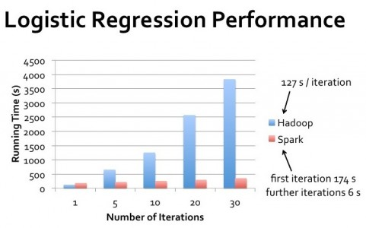
Spark
Apache .Spark is a fast, in-memory data processing engine
Source: edurekha

Slide 28
The Spark Ecosystem
Spark SQL & Data Frames
Spark Streaming
ML-Lib
Graphx
Spark Core

Slide 29
Spark RDD – Resilient Distributed Dataset
Resilient – Can be retrieved from lineage
Distributed – Is distributed(multiple clusters)
Dataset – contains data
Spark can be implemented in scala, python and java
Scala and Python are widely used as they are functional programing languages

